Slide 1
International Islamic University Chittagong
Department of Computer and Communication Engineering
Course Code: CCE-3507
Course Title: System Analysis, Design and Development
Abu Raihan Anchari Miskat
Adjunct Faculty
Dept. of CCE, IIUC

Slide 2
SOFTWARE ENGINEERING PROCESSES
A software engineering process is the model chosen for managing the creation of software
from initial customer inception to the release of the finished product.
The chosen process usually involves techniques such as:
  Analysis,
  Design,
  Coding,
  Testing and
  Maintenance

Slide 3
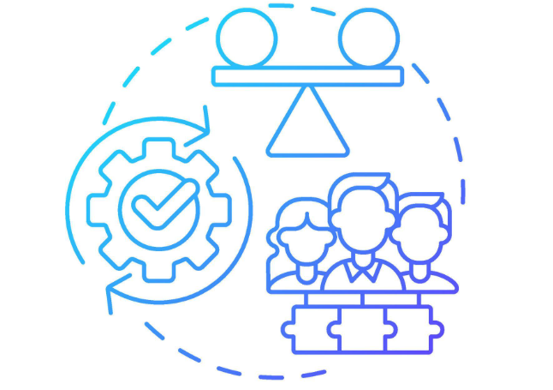

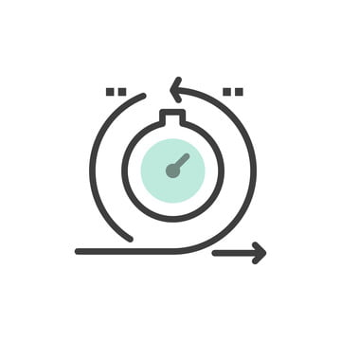
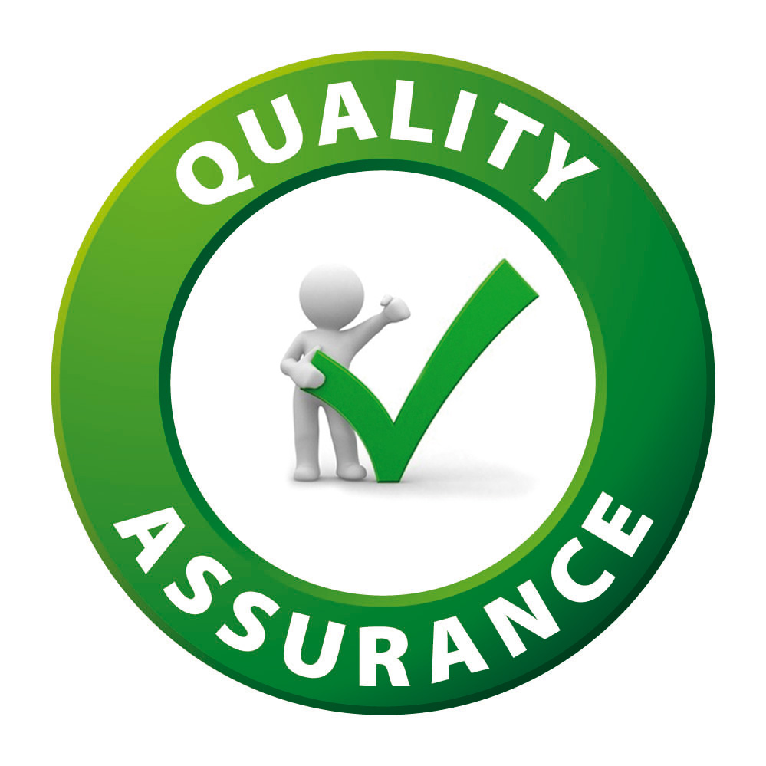

Importance of Software Processes
Stability
A structured approach organizes tasks effectively, leading to predictable outcomes.
Control
Ensures adherence to each development step, minimizing the risk of errors and omissions.
Agility
Processes can be tailored to meet specific project requirements, enhancing flexibility.
Quality Assurance
Systematic processes lead to the production of high-quality software, reducing defects.
Timeliness
Structured processes facilitate timely project delivery, meeting deadlines effectively.

Slide 4
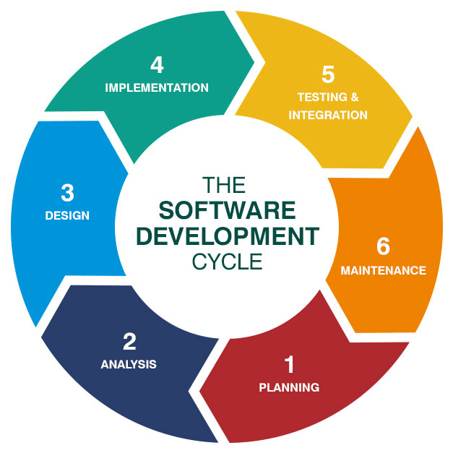
Systems Development Life Cycle (SDLC)
The SDLC is the process of determining how an information system (IS) can support business needs, designing the system, building it, and delivering it to users.

Slide 5
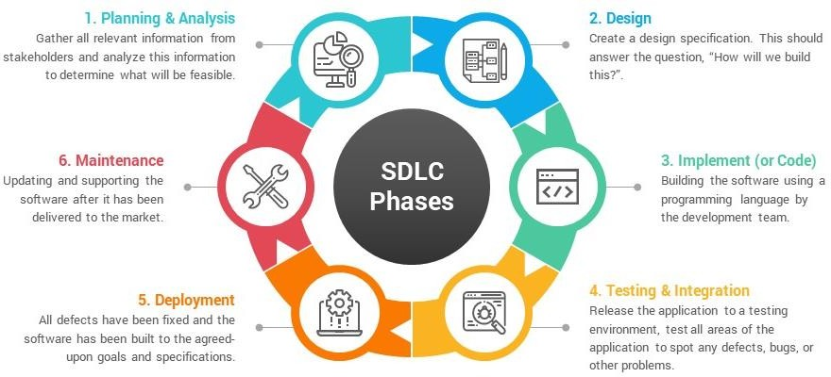
Systems Development Life Cycle (SDLC)

Slide 6
Systems Development Life Cycle (SDLC)
Planning and analysis:
  Feasibility Study+ JAD → SRS (Software Requirement Specification)
Design:
  Specify the hardware, system requirement and design the application architecture and database design.
  Design: high-level design and low-level design.
  In high-level design, we design the different blocks of the application.
  In low-level design, we write the pseudo-code.
Implementation / Coding:
  The work is divided in modules/units and actual coding is started.
  This is the longest phase of the software development life cycle.

Slide 7
Systems Development Life Cycle (SDLC)
Testing:
  After the code is developed it is tested against the requirements
  Functional testing like unit testing, integration testing, system testing, acceptance testing is done
  Non-functional testing is also done.
Deployment:
  After successful testing the product is delivered / deployed to the customer for their use.
  During deployment, there are four widely used strategies i.e., Parallel, Direct, Phased and Pilot.
  Parallel: Old and new systems are used at the same time
  Direct: Old is replaced by new one
  Phased: Parts of the new system are implemented over time
  Pilot (Single Location): Entire System used, is used in one location

Slide 8
Systems Development Life Cycle (SDLC)
  Maintenance:
    Corrective Maintenance: to correct errors
    Perfective Maintenance: to enhance the functionalities of the system
    Adaptive Maintenance: for porting the software to work in a new environment

Slide 9
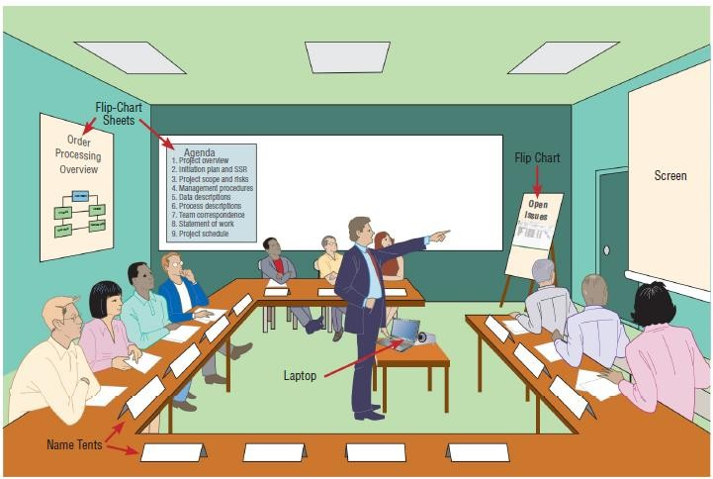
Joint Application Design (JAD)
Joint application development (JAD) is a structured process in which users, managers, and analysts work together for several days in a series of intensive meetings to specify or review system requirements.
It was developed by IBM in the late 1970s.
Figure: A typical room layout for a JAD session

Slide 10
Joint Application Design (JAD)
JAD participant | Role
JAD project leader | Develops an agenda, acts as a facilitator, and leads the JAD session
Top management | Provides enterprise-level authorization and support for the project
Managers | Provide department-level support for the project and understanding of how the project must support business functions and requirements
Users | Provide operational-level input on current operations, desired changes, input and output requirements, user interface issues, and how the project will support day-to-day tasks
Systems analysts and other IT staff members | Provide technical assistance and resources for JAD team members on issues such as security, backup, hardware, software, and network capability
Recorder | Documents results of JAD sessions and works with systems analysts to build system models and develop CASE tool documentation

Slide 11
JAD Process Steps
Define Session: Define the purpose, scope, and objectives of the JAD session, selecting the JAD team, invite and obtain commitment to attend sessions from the appropriate stakeholders, and schedule the session.
Research Product: Become more familiar with the product or service, gather preliminary information, obtaining any models.
Prepare: Prepare any visual aids, developing a realistic agenda, training the recorder, and preparing the meeting room.
Conduct Session: Follow agenda to gather and document the project needs and requirements. It is important to ensure all participants are given equal treatment during the process.
Draft the Documents: Prepare the formal documents. The JAD session's information is refined through analysis, open questions or issues are resolved, and the final document is returned to stakeholders for review and validation.

Slide 12
JAD Advantages & Disadvantages
Advantages:
This technique allows for the simultaneous gathering and consolidating of large amounts of information.
This technique provides a forum to explore multiple points of view regarding a topic.
This technique produces relatively large amounts of high-quality information in a short period of time.
Disadvantages:
Requires significant planning and scheduling effort.
Requires trained and experienced personnel for facilitation and recording.

Slide 13
Some SDLC Methodologies
Waterfall Model
  Classical Waterfall Model
  Parallel Waterfall Model
  Waterfall V Model
Spiral Model
Agile Methodologies
Other Practices :
  Rapid Application Development (RAD)

Slide 14
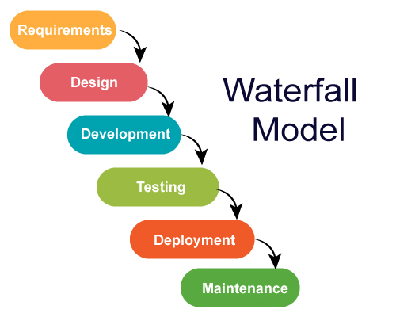
Classical Waterfall Model
The model has six phases

Slide 15
Classical Waterfall Model
Advantages:
  The requirements are clearly and accurately stated
  Detailed documentation
  Careful planning
  The start and end points for each phase are set
  It provides easy control and transparency for the customer due to a strict reporting system.
  The waterfall method is still preferred by some developers because of its predictability and known costs.

Slide 16
Classical Waterfall Model (Cont.)
Disadvantages:
  It is not desirable for complex project where requirement changes frequently
  Testing period comes quite late in the developmental process
  Documentation occupies a lot of time of developers and testers
  Clients valuable feedback cannot be included with ongoing development phase
  Small changes or errors that arise in the completed software may cause a lot of problems.
When to Use the Waterfall Model
  When quality is more important than cost or schedule.
  When requirements are very well known, clear, and fixed.
  New version of existing product is needed.
  Porting an existing product to a new platform

Slide 17
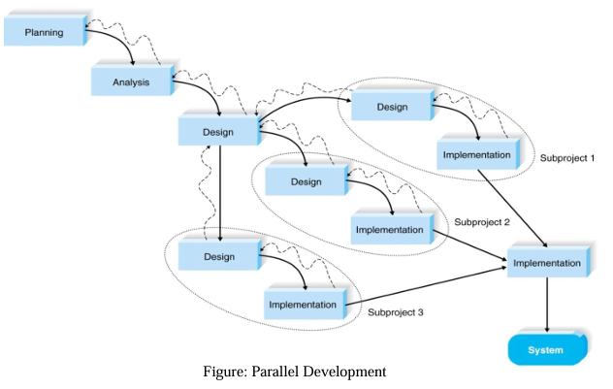
Parallel Waterfall Model
Here, instead of doing the design and implementation in sequence, a general design for the whole system is performed.
Then the project is divided into a series of subprojects that can be designed and implemented in parallel.

Slide 18
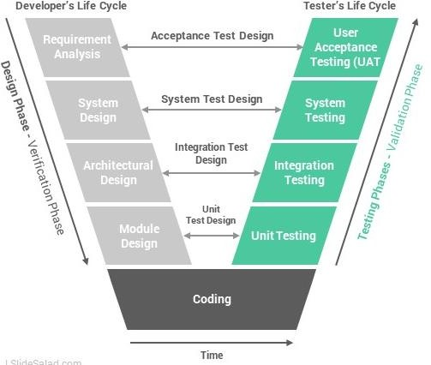
Waterfall V Model
V-Model is software development model and V-model is also known as Verification and Validation model.
It is basically extension of waterfall model but unlike water fall model here in V-model, testing is done simultaneously with the development phase. The main disadvantage of water fall model i.e., the Testing Starts after Development ends. But in V-model the testing starts early in life cycle.

Slide 19
Waterfall V Model
Verification Phase of V-model
Business requirement analysis: This is the first step where product requirements understood from the customer's side.
System Design: This stage is used to generate a specification document that will outline all technical components such as the data layers, business logic, and so on.
Architecture Design: During this stage, specifications are drawn up that detail how the application will link up all its various components, either internally or via outside integrations. Often this is referred to as high-level design.
Module Design: This phase consists of all the low-level design for the system, including detailed specifications for how all functional, coded business logic will be implemented.
Coding Phase: Based on the requirements, a suitable programming language is decided. There are some guidelines and standards for coding.

Slide 20
Waterfall V Model (Cont.)
Validation Phase of V-model
Unit Testing: UTPs are executed to eliminate Unit testing verifies that the smallest entity can function correctly when isolated from the rest of the codes/ units. errors at code level or unit level.
Integration Testing: Testing devised during the architecture design phase are executed here, ensuring that the system functions across all components and third-party integrations.
System Testing: System Test ensures that expectations from an application developer are met.
Acceptance Testing: It includes testing the software product in user atmosphere. It conjointly discovers the non-functional problems like load and performance defects within the real user atmosphere.

Slide 21
Waterfall V Model
Advantages:
  Less bugs: Do testing in every layer
  Higher chance of success
  Works well for small projects where requirements are easily understood.
  Time Saving
  Proactive defect tracking
Disadvantages:
  No feedback so less scope of changes
  Risk analysis is not done
  Not good for big or object-oriented projects

Slide 22
Waterfall V Model
  When to Use the Waterfall V Model
    The V-shaped model should be used for small to medium-sized projects where requirements are clearly defined and fixed.

Slide 23
Spiral Model
The Spiral Model is a combination of the waterfall model and the iterative model.
It provides support for Risk Handling.
Phase 1: Planning objectives & identify alternative solutions: In first phase of the spiral model we clarify what the project aims to achieve, including functional and non-functional requirements.
Phase 2: Identifying and resolving the risks : In the risk analysis phase, the risks associated with the project are identified and evaluated.
Phase 3: Develop the next level of product : As this stage proceeds to the end of this third quadrant, new software or the next version of existing software is ready to deliver.
Phase 4: Planning the next cycle : The next iteration of the spiral begins with a new planning phase, based on the results of the evaluation.

Slide 24
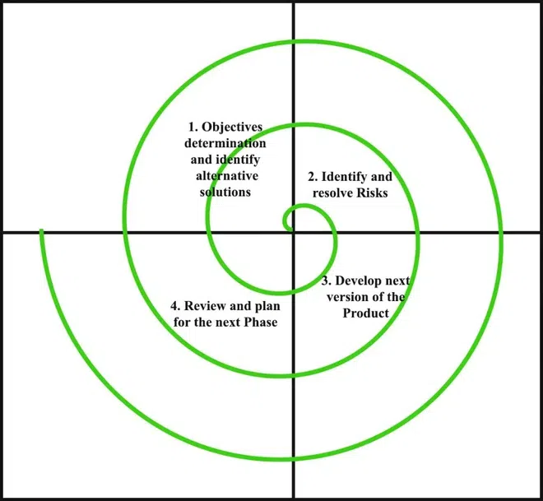
Spiral Model

Slide 25
Spiral Model
Advantages:
  Suitable for large projects
  Risk Handling
  Customer Satisfaction
  Requirement’s flexibility
  Improved Quality
Disadvantages:
  Not good for small projects.
  More Complex
  It can be much expensive.
  Difficulty in time management
  When to Use the Spiral Model
    For high-risk projects.
    For medium and big projects.
    Requirements are complex
    Users are unsure of their needs
    If frequent changes required in the project.

Slide 26
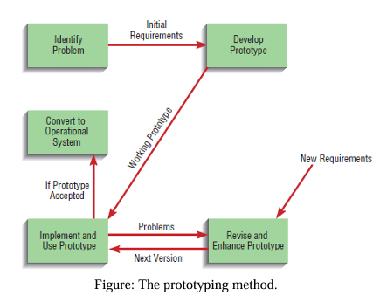
Prototyping
A prototype is an early working version of an information system. Prototyping tests system concepts and provides an opportunity to examine input, output, and user interfaces before final decisions are made.

Slide 27
Prototyping
Advantages of Prototyping:
  ✓ Prototyping is most useful for requirements determination when user requirements are not clear or well understood.
  ✓ There is a possibility of developing a system that more closely addresses users’ needs and expectations.
Disadvantages of Prototyping:
  ✓ It can be quite difficult to manage prototyping as a project in the larger systems effort.
  ✓ Decisions might be made too early, before business or IT issues are understood thoroughly.

Slide 28
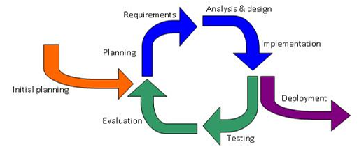
Iterative development Approach
Iterative - performing repeatedly, i.e. adding new functionality in a repetitive or cyclic manner

Slide 29
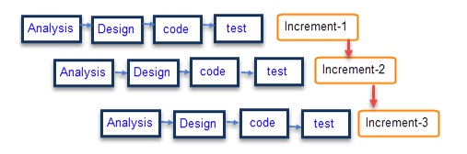
Incremental development Approach
Incremental - adding new functionality in small chunks

Slide 30
Comparison of Various SDLC Models
(Heavyweight Methodology)
Properties of Model | Water Fall Model | Incremental Model | Spiral Model
Planning in early stage | Yes | Yes | Yes
Handle Large-Project | Not Appropriate | Not Appropriate | Appropriate
Detailed Documentation | Necessary | Yes but not much | Yes
Cost | Low | Low | Expensive
Requirement Specifications | Beginning | Beginning | Beginning
Flexibility to change | Difficult | Easy | Easy
User Involvement | Only at beginning | Intermediate | High
Maintenance | Least | Promotes Maintainability | Typical
Risk Involvement | High | Low | Medium to high risk
Testing | After completion of coding phase | After every iteration | At the end of the engineering phase
Team size | Large Team | Not Large Team | Large Team

Slide 31
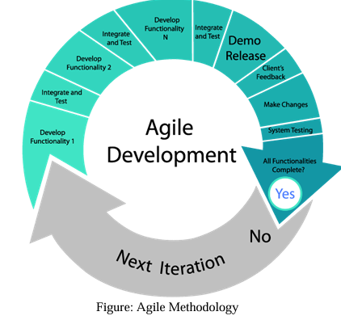
Agile Model
Agile methodologies are iterative and incremental, which means it's known for breaking a project into smaller parts and adjusting to changing requirements.

Slide 32
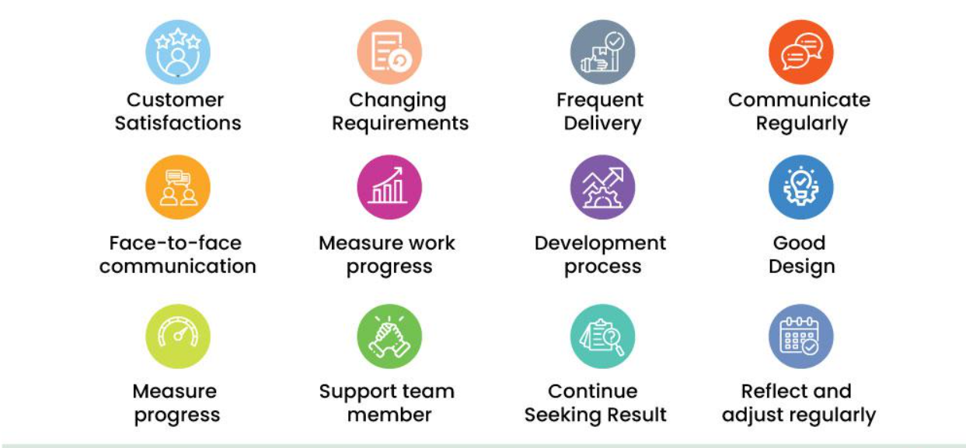
Agile Model

Slide 33
Agile Model
The main steps for Agile project management are as follows:
In the Agile methodology, each project is broken up into several Iterations ‘.
All Iterations should be of the same time duration (between 2 to 8 weeks).
At the end of each iteration, a working product should be delivered.
In simple terms, in the Agile approach the project will be broken up into 10 releases (assuming each iteration is set to last 4 weeks).
Rather than spending 1.5 months on requirements gathering, in Agile software development, the team will decide the basic core features that are required in the product and decide which of these features can be developed in the first iteration.
Any remaining features that cannot be delivered in the first iteration will be taken up in the next iteration or subsequent iterations, based on priority.
At the end of the first iterations, the team will deliver a working software with the features that were finalized for that iteration.
There will be 10 iterations and at the end of each iteration the customer is delivered a working software that is incrementally enhanced and updated with the features that were shortlisted for that iteration.

Slide 34
Agile Model
Advantages :
  Continuous attention to technical excellence and good design.
  Customer satisfaction by rapid, continuous delivery of useful software.
  People and interactions are emphasized rather than process and tools. Customers, developers and testers constantly interact with each other.
  Working software is delivered frequently (weeks rather than months).
  Face-to-face conversation is the best form of communication.
Disadvantages :
  In case of some software deliverables, especially the large ones, it is difficult to assess the effort required at the beginning of the software development life cycle.
  There is lack of emphasis on necessary documentation.
  The project can easily get taken off track if the customer representative is not clear what final outcome that they want.
  Only senior programmers are capable of taking the kind of decisions required during the development process.

Slide 35
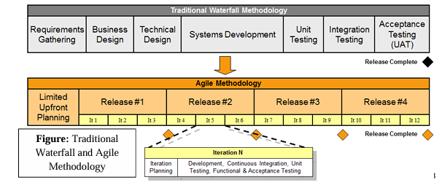
AGILE Model VS Waterfall model

Slide 36
AGILE Model VS Waterfall model
Agile Model | Waterfall Model
Incremental and iterative approach to software design. | Sequential flow from start to end.
Broken into individual models for designers. | Not broken into individual models.
Early and frequent opportunities to give feedback and request changes. | Customer only sees the final product at the end.
Errors can be fixed in the middle of the project. | Errors discovered at the end; may require restarting from the beginning.
Iterative, with short iterations (2–4 weeks); minimal planning. | Phased development; each phase larger and ends with full documentation for the next phase.
Less priority than software development. | High priority; used for training and upgrading software with other teams.
Every iteration has testing; allows regression testing of new functions. | Testing only after development phase is complete; partial systems not functional.
Shippable features delivered after some iterations; features usable immediately. | Full product delivered only after full implementation.
Testers and developers work together closely. | Testers work separately from developers.
Strong communication with developers for frequent feedback. | Customer not involved after planning until final delivery.

Slide 37
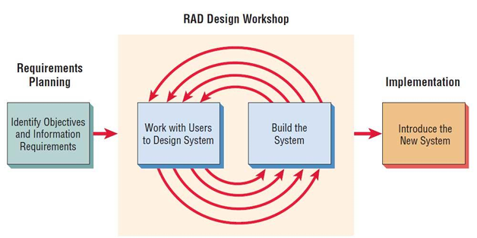
Rapid Application Development (RAD)
The RAD model is a type of incremental process model.
The RAD model is used when the requirements are fully understood and the component-based construction approach is adopted.
Figure: Phases in the James Martin approach to RAD

Slide 38
Rapid Application Development (RAD)
The James Martin approach to RAD divides the process into four distinct phases:
  Requirements planning phase :
  User design phase :
  Construction phase : Focuses on program and application development task similar to the SDLC. In RAD, however, users continue to participate and can still suggest changes or improvements as actual screens or reports are developed. Its tasks are programming and application development, coding, unit-integration and system testing.
  Cutover phase : All the interfaces between the independent modules developed by separate teams have to be tested properly. The use of powerfully automated tools and subparts makes testing easier. This is followed by acceptance testing by the user.

Slide 39
Rapid Application Development (RAD)
Advantages:
  The use of reusable components helps to reduce the cycle time of the project.
  Feedback from the customer is available at the initial stages.
  Reduced costs as fewer developers are required.
  The progress and development of the project can be measured through the various stages.
  It is easier to accommodate changing requirements due to the short iteration time spans.
Disadvantages:
  The use of powerful and efficient tools requires highly skilled professionals.
  The absence of reusable components can lead to the failure of the project.
  The team leader must work closely with the developers and customers to close the project on time.

Slide 40
Rapid Application Development (RAD)
When to Use the RAD Model
  Well-understood Requirements
  Time-sensitive Projects
  Small to Medium-Sized Projects
  High User Involvement
  Innovation and Creativity

Slide 41
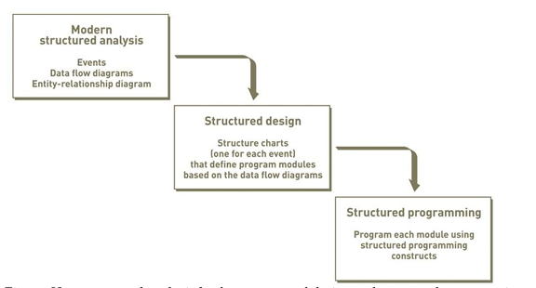
Structured Approach
The Structured Approach Structured analysis, structured design, and structured programming are the three techniques that make up the structured approach are collectively referred to as the structured analysis and design technique (SADT).

Slide 42
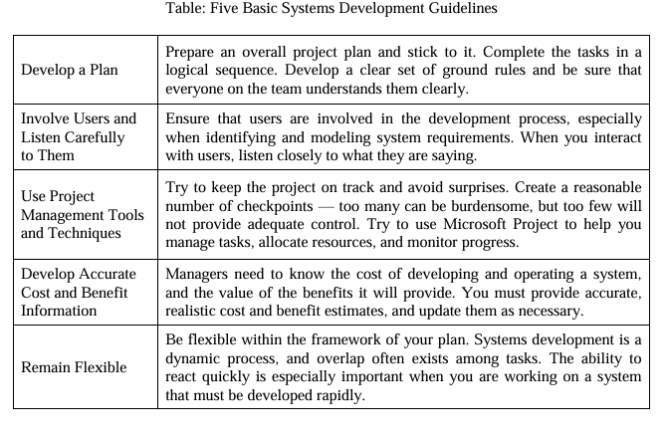

Slide 44
Thank You

